Slide 1
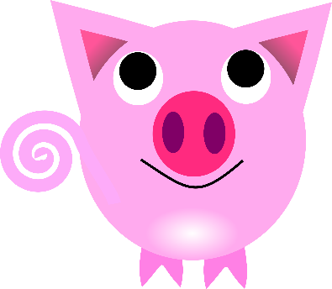
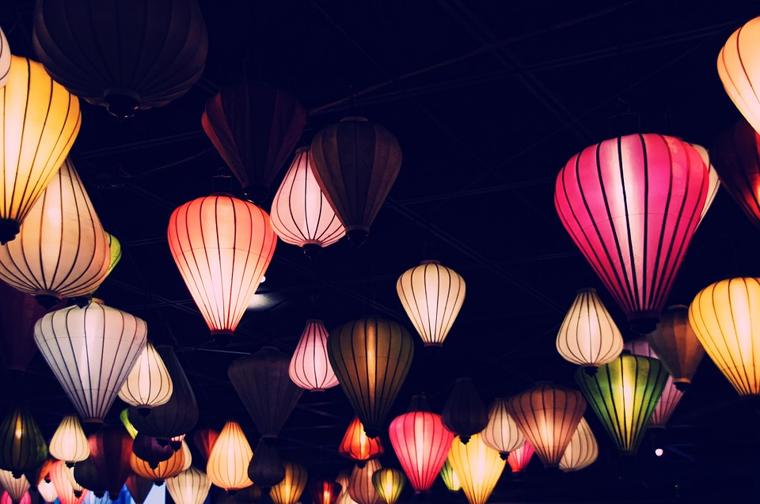
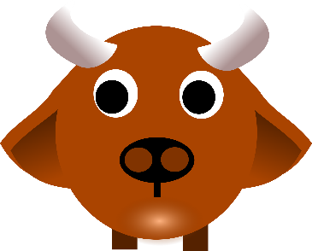
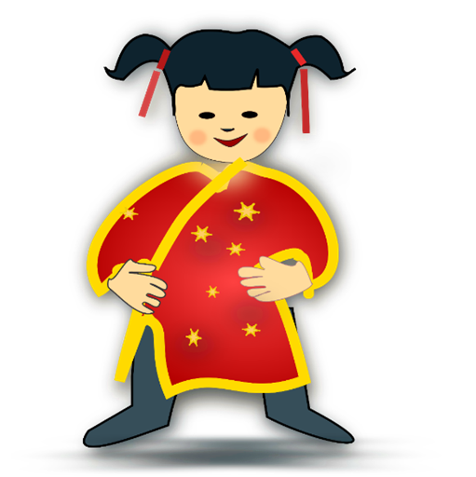
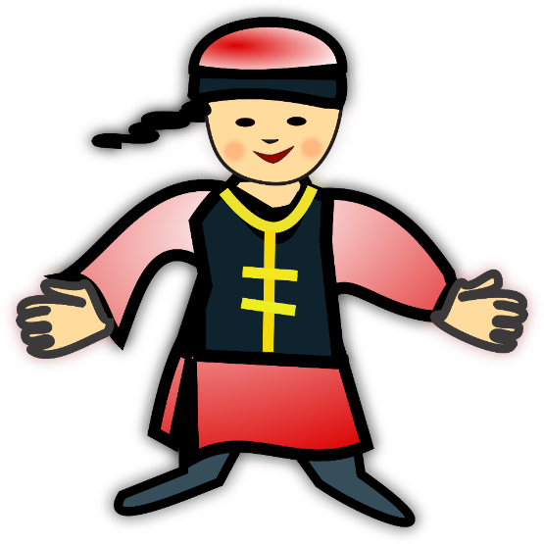
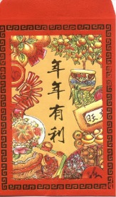
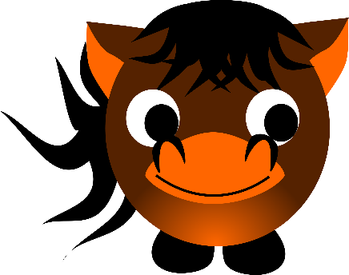
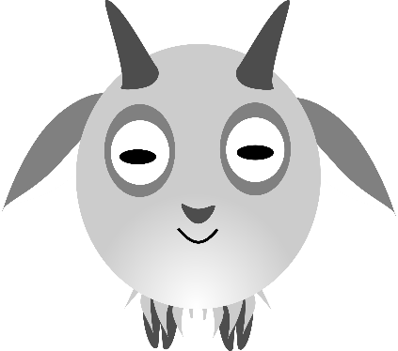
新 年 快 樂
Chinese New Year
Kung Hei Fat Choy
That’s ‘Happy New Year’ in Chinese.

Slide 2
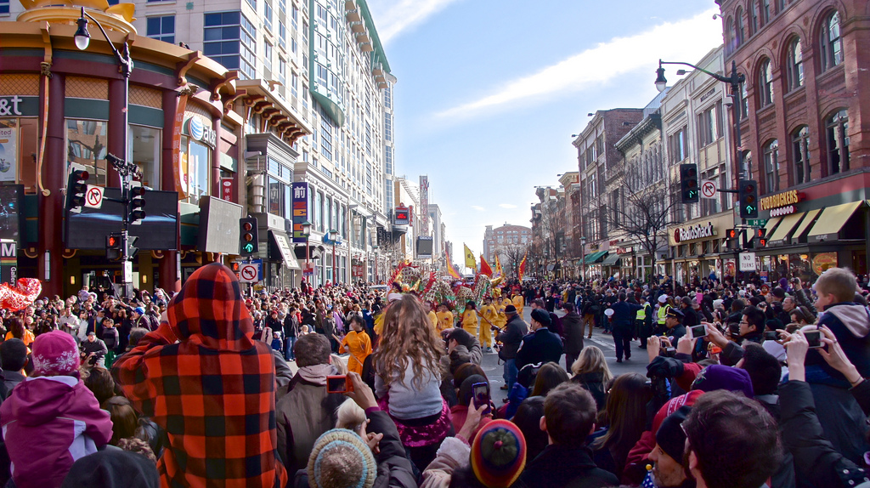
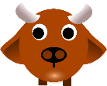
One in every six people in the world celebrate Chinese New Year. Customs vary but the main idea is to remember family and wish everyone peace and prosperity in the coming year.
Notes:
https://www.flickr.com/photos/taedc/8463718666/sizes/l

Slide 3
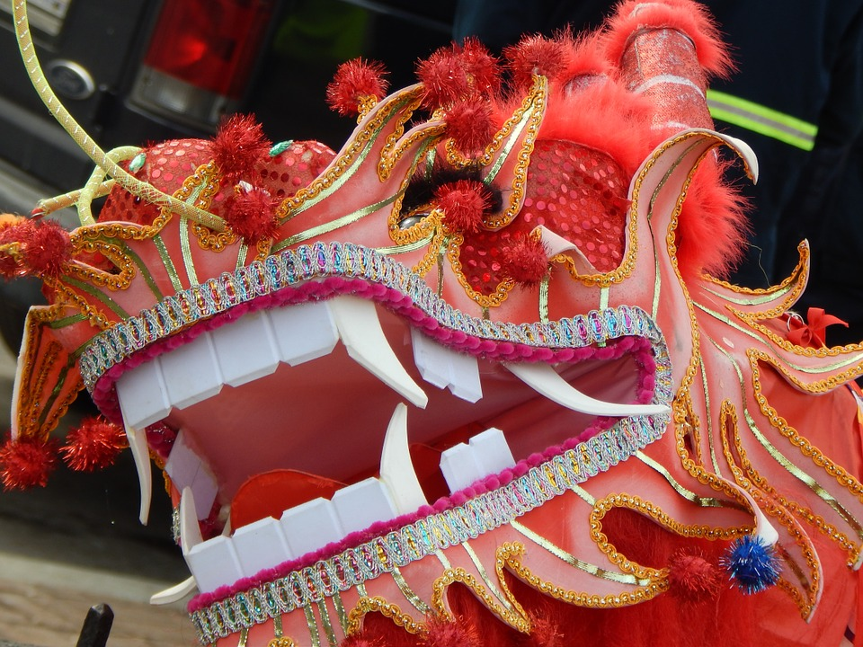
Chinese New Year is also known as the Spring Festival. It is the biggest and most important festival in China and is celebrated in Chinese communities all over the world.

Slide 4
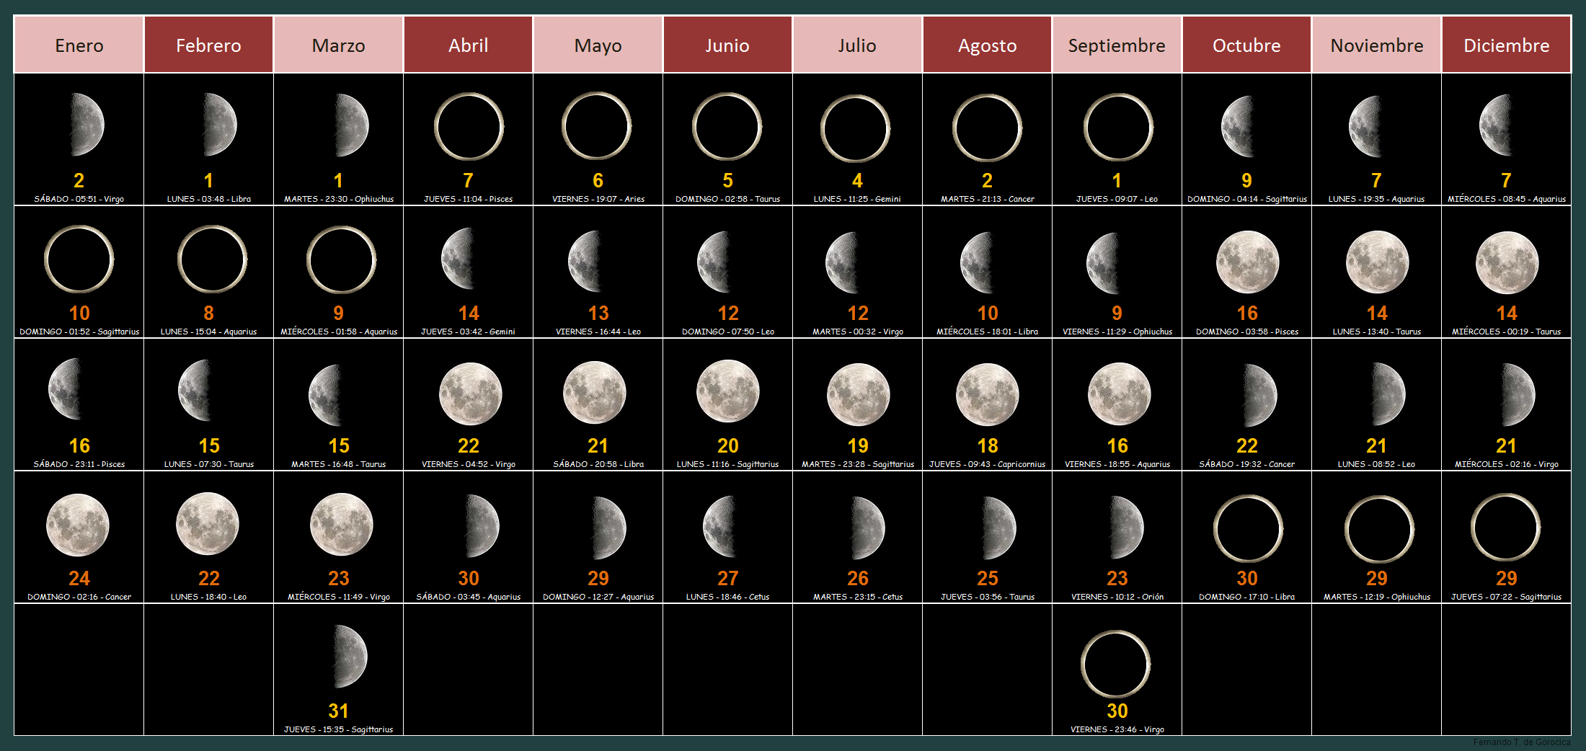
The date of Chinese New Year is based on the lunar calendar and the date changes each year.
Notes:
https://commons.wikimedia.org/wiki/File:Calendario_Lunar_2016.png

Slide 5
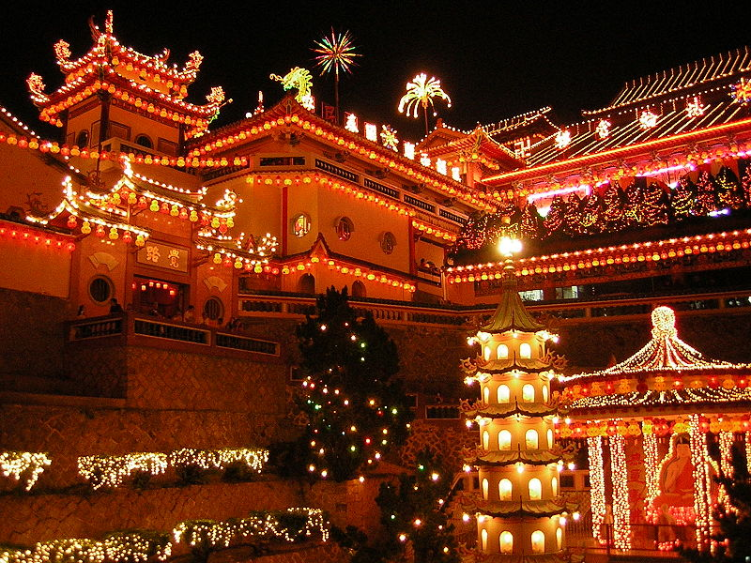
The first day of the New Year falls between 21st January and 20th February. Celebrations last for 15 days from Chinese New Year’s Eve to the Lantern Festival.
Notes:
https://commons.wikimedia.org/wiki/File:Ke_Lok_Si_Illuminations_01.JPG

Slide 6
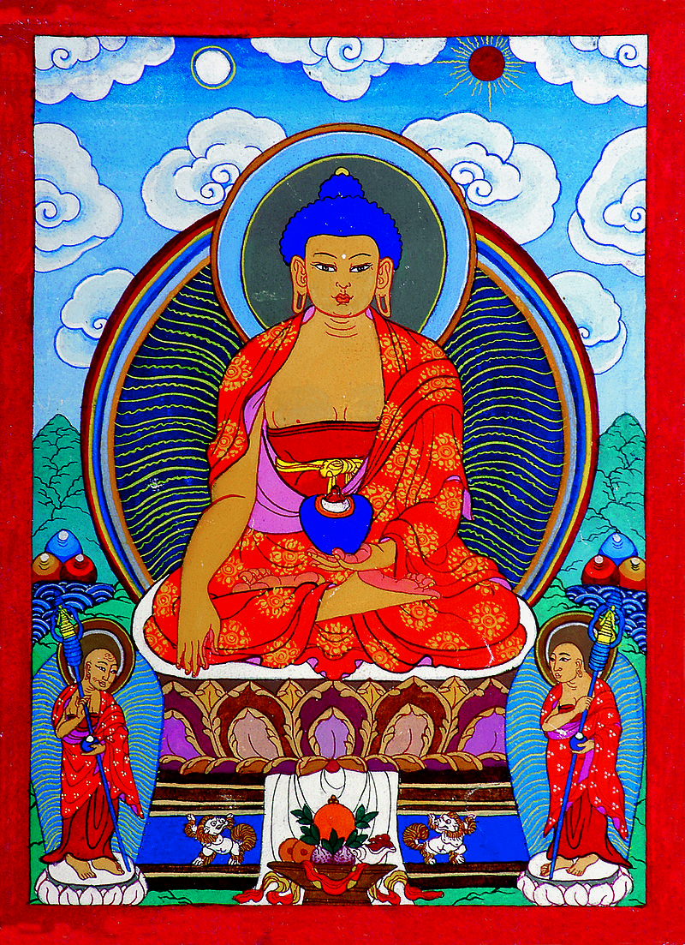
There are several legends about how the Chinese New Year came about.
Notes:
By Otgo Otgonbayar Ershuu - Own work http://www.mongolian-art.de/galerie_buddha_goetter/index.htm, CC BY 3.0, https://commons.wikimedia.org/w/index.php?curid=25335461

Slide 7
One legend is that Lord Buddha called together all the animals in the animal kingdom to say goodbye before he left Earth. Only twelve came. He rewarded them by naming a year after each one in the order they arrived.
Notes:
By Otgo Otgonbayar Ershuu - Own work http://www.mongolian-art.de/galerie_buddha_goetter/index.htm, CC BY 3.0, https://commons.wikimedia.org/w/index.php?curid=25335461

Slide 8
Another legend tells the story of a swimming race. Many years ago there was a rat, an ox, a tiger, a rabbit, a dragon, a snake, a horse, a goat, a monkey, a rooster, a dog and a pig.

Slide 9
The animals argued about who was to be first in the cycle of years. They asked the Gods to decide.
No I should !
I should be first.
But I’m the most important!

Slide 10
The Gods decided that there should be a swimming race. Whoever came first would be first in the cycle, the rest of the animals would be in the order they finished.

Slide 11
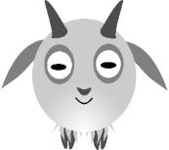
1st
rat
2nd
ox
3rd
tiger
4th
rabbit
5th
dragon
6th
snake
7th
horse
8th
goat
9th
monkey
10th
rooster
11th
dog
12th
pig
This was the final order.
Notes:
Notes: Just click once – the animals will appear automatically

Slide 12
1st
rat
2nd
ox
3rd
tiger
4th
rabbit
5th
dragon
6th
snake
7th
horse
8th
goat
9th
monkey
10th
rooster
11th
dog
12th
pig
The calendar has followed a rotating cycle ever since then.

Slide 13
Click on the animals to see and hear the story.

Slide 14
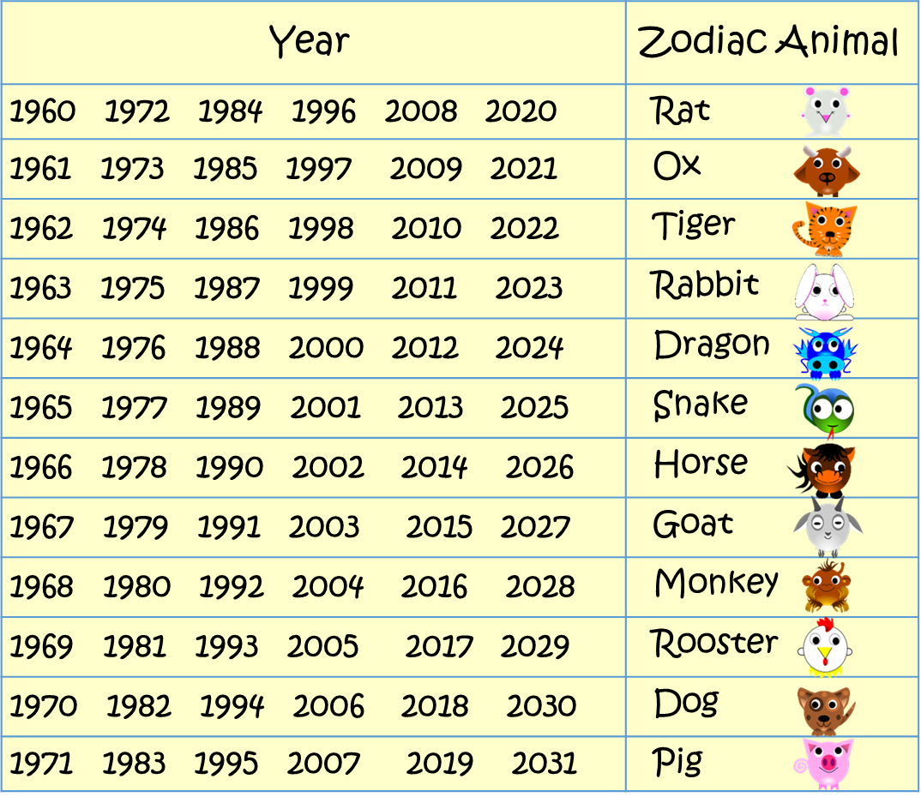
What is your zodiac animal? Find the year you were born in. Then look for the animal.
Here is the Chinese Calendar.

Slide 15
What year will 2021 be?
It will be the year of the ox!

Slide 16
Yes, 2021 is the Year of the ox.
Notes:
https://commons.wikimedia.org/wiki/File:DogYearPaperCutting.jpg

Slide 17
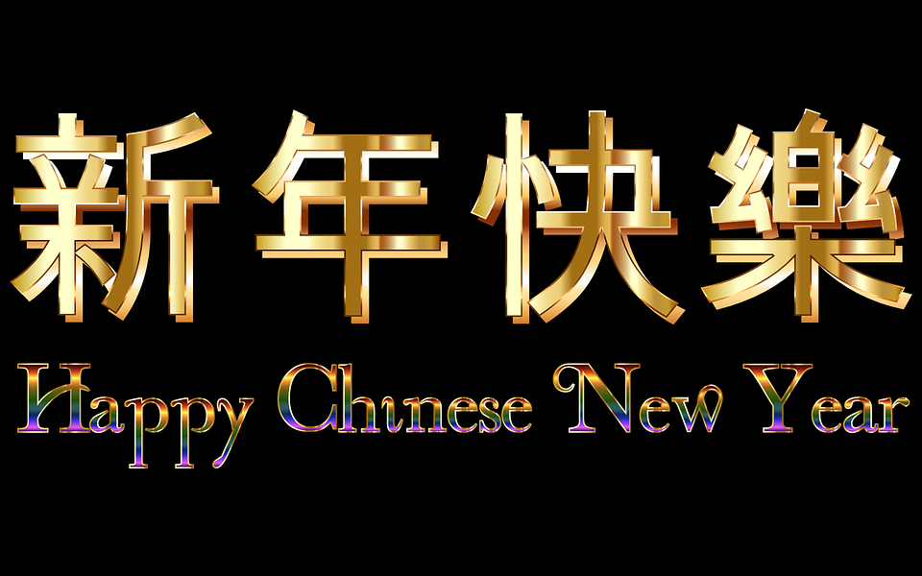
Kung Hei Fat Choy
Kung Hei Fat Choy

Slide 18
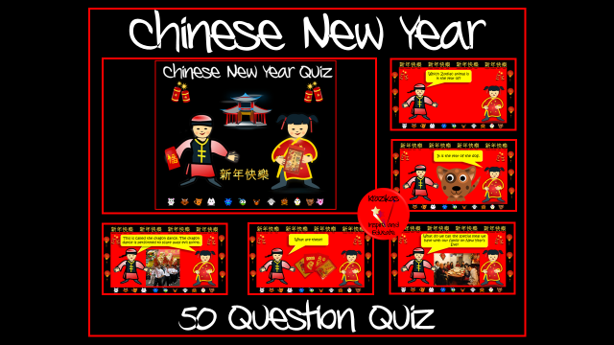
You may also like our more detailed Chinese New Year Presentation and our Quiz
Click on the image for details.

Slide 19
For more inspiring educational resources by Krazikas click on the banner!

